Slide 1
CLEANED – Virtual Training 22nd /06/2020 – 03rd /07/2020
Jessica Mukiri, An Notenbaert, Emmanuel Mwema, Birthe Paul, Rein Van der Hoek
cleaned@cgiar.org
CLEANED virtual training: 26/06/2020

Slide 2

Recap
Notes:
Show Agenda again

Slide 3
Present Assignment 2

Slide 4
Learning outcomes day 3
Choose/select, the appropriate indicators based on research questions answered (e.g. selecting absolute vs relative, per ha, per enterprise etc.)
Illustrate results using output from CLEANED
Interpret results using benchmarks

Slide 5
Results

Slide 6
Results overview
Summary
Land requirements
Productivity
Water impacts
Economics
Soil impacts
GHG emissions
Notes:
Show some different Outputs

Slide 7

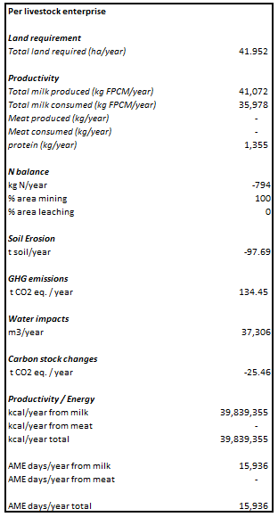
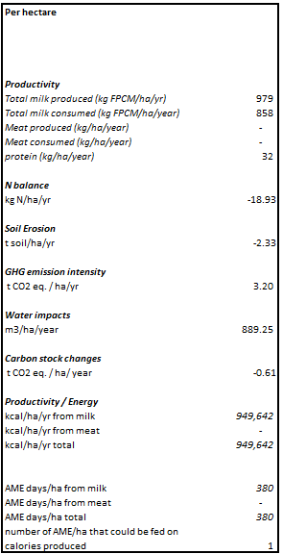
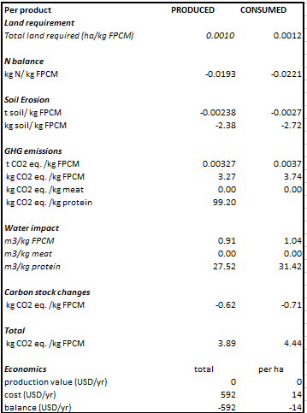
Summary
Notes:
Discuss the units in per livestock enterprise/Per hectare/Per product - Relative vs Asbolute values

Slide 8
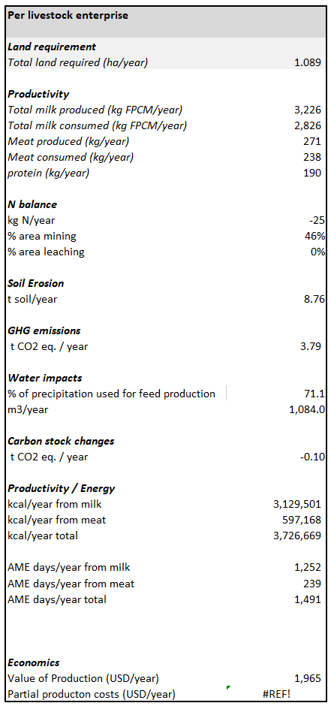

Slide 9
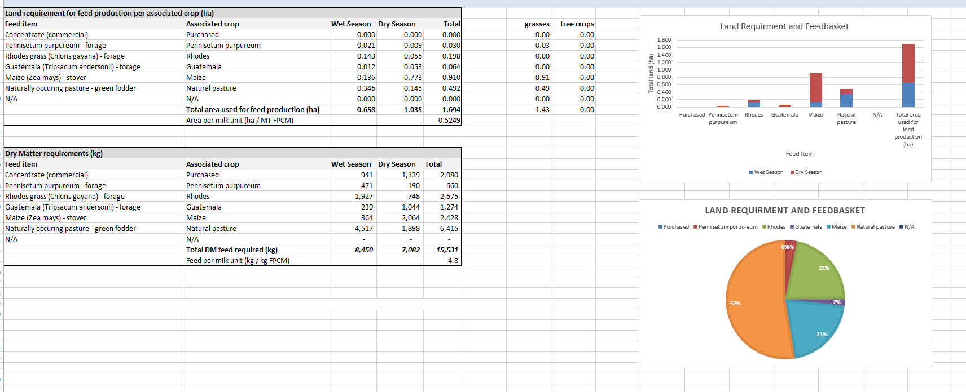
Land output as seen in CLEANED
Notes:
The results in ha/ also results have 3 seasons

Slide 10
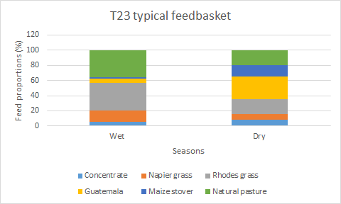
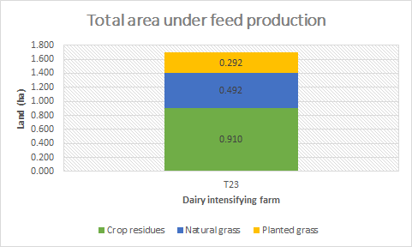
Land output – Report
Notes:
Different way of presenting the outputs

Slide 11
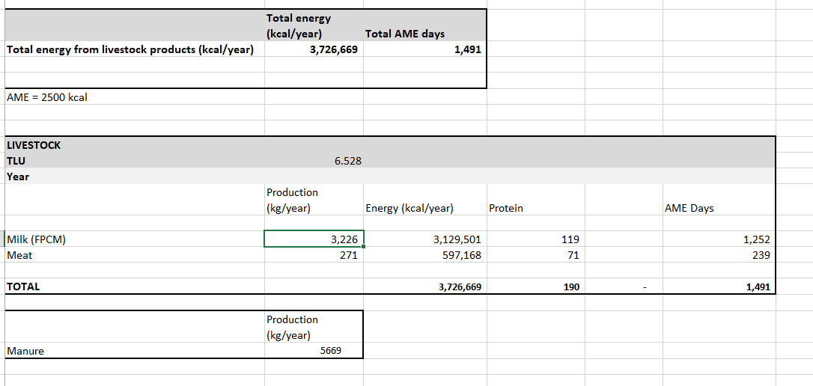
Productivity output as seen in CLEANED
Notes:
once again that these results are in fact input data

Slide 12
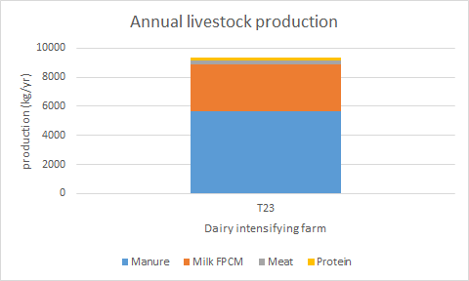
Productivity output - Report

Slide 13
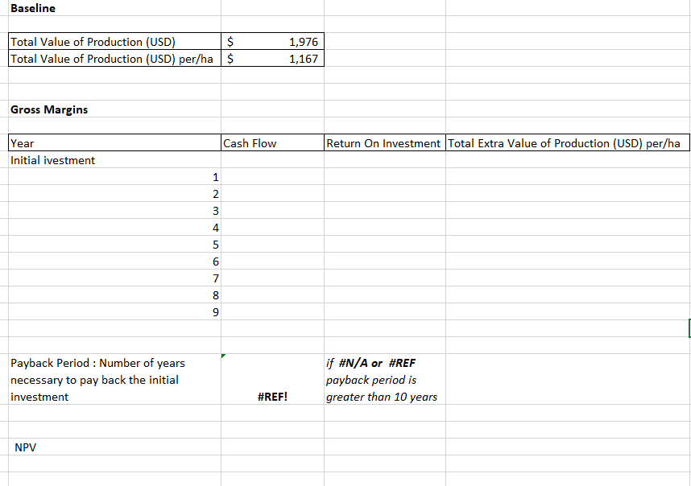
Economics as seen in CLEANED

Slide 14
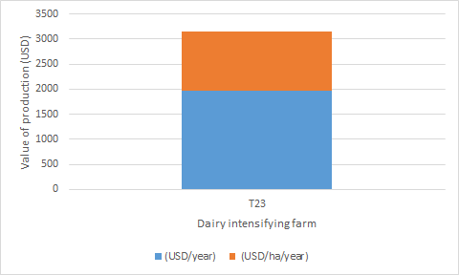
Economics output - Report

Slide 15

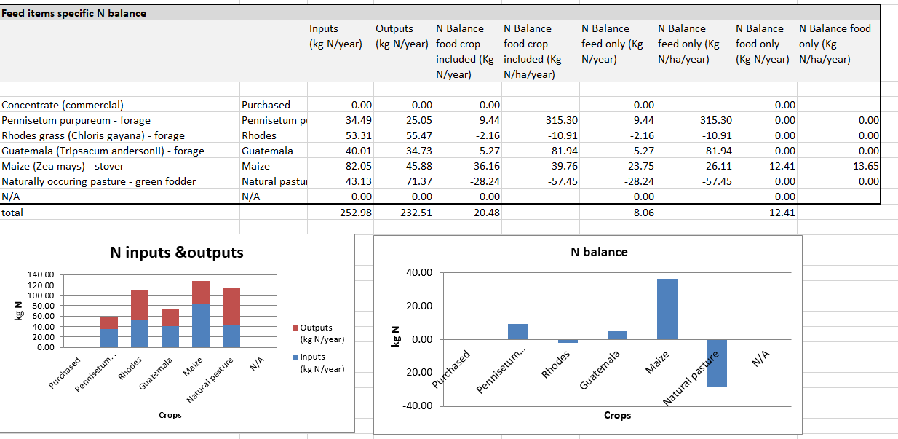
Soil health as seen in CLEANED

Slide 16
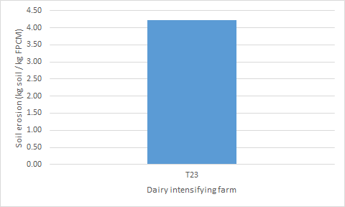
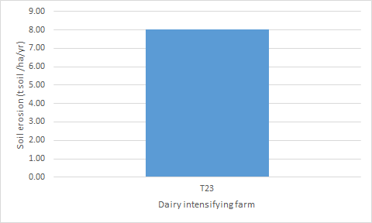
Soil health output - Report

Slide 17
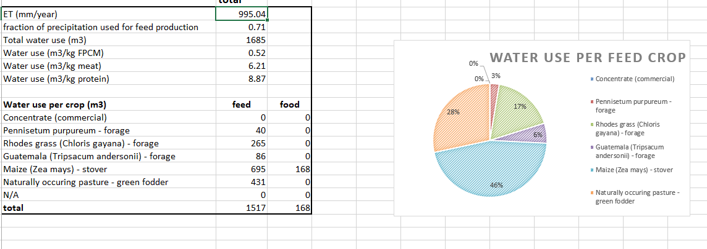
Water impacts as seen in CLEANED

Slide 18
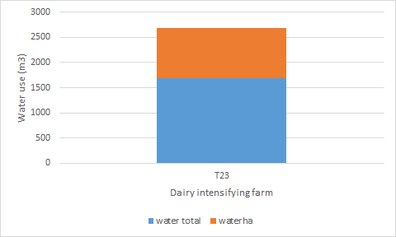
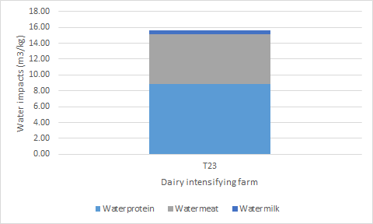
Water impacts outputs - Report

Slide 19
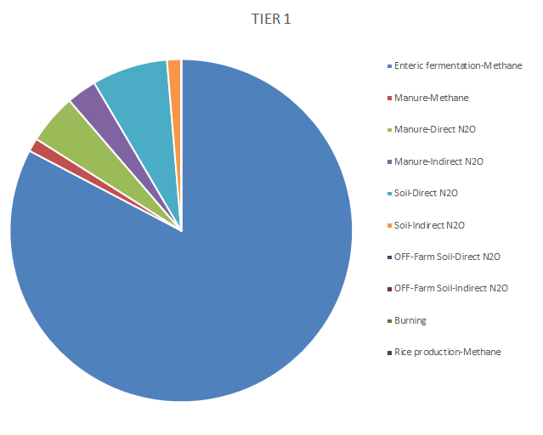
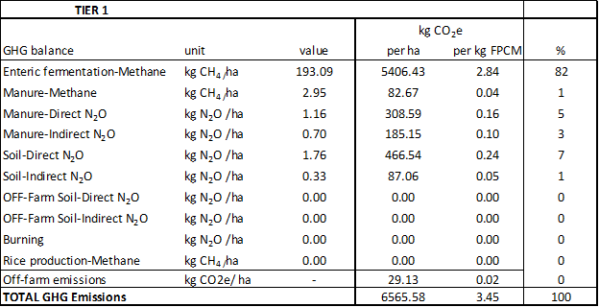
GHG emissions as seen in CLEANED

Slide 20
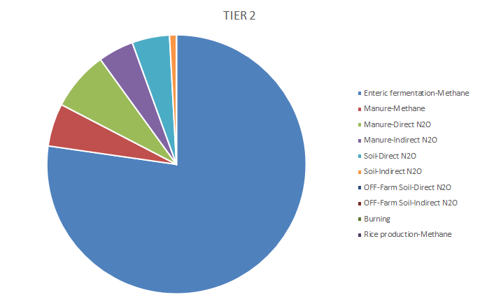
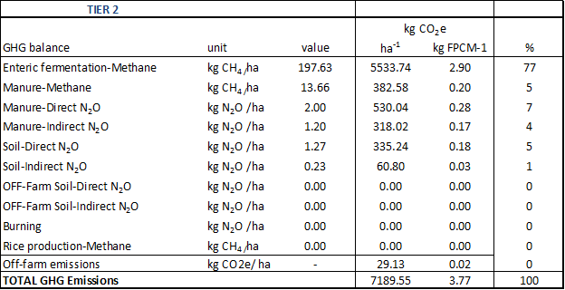
GHG continued

Slide 21
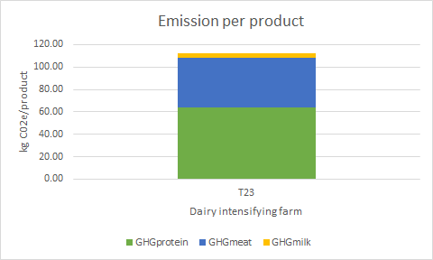
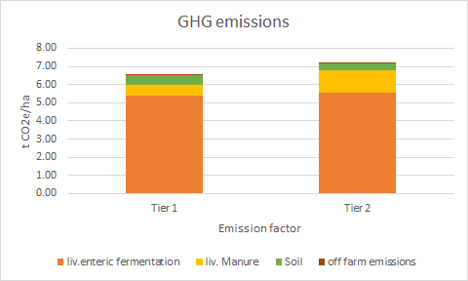
GHG emissions output - Report

Slide 22
Reports & Outputs

Slide 23
BREAKOUT 1
Based on your dairy enterprise, check the outputs in terms of land requirements, soil health, water and ghg. Do these represent what is going on the ground, which dimensions are easy to verify which ones are hard and why?
https://docs.google.com/presentation/d/1AlS5cXYTvm6KD1JXfLbO48dlJxQr2kCukLqC84_ySX4/edit?usp=sharing

Slide 24
Quiz 3
Link to Quiz 3
https://forms.office.com/Pages/ResponsePage.aspx?id=AA76ahT6t0CKLiKn-MNX1aE1vfzSBf5GkjzzKvqgj8ZUQ01VMDc1SE0xTlc2VEdYSVJVRk8wNFlBWi4u

Slide 25
Assignment 3
Based on your dairy enterprise, select one indicator, using graphs show the difference between the Tanzania dairy farm and your farm, which farm is more environmentally friendly and why?
Submit excel with graphs with all indicators filled in
Submit two ppt slides showing and explaining the difference, choosing one indicator
https://form.jotform.com/201763361804048

Slide 26
Pre-recorded material
To access the CLEANED workbook please see
link: https://cleanedtraining.netlify.app/
To go directly to day 3: https://cleanedtraining.netlify.app/hands-on-with-the-input-section.html

Slide 27
Recap on what to do?
Quiz 3 :
https://forms.office.com/Pages/ResponsePage.aspx?id=AA76ahT6t0CKLiKn-MNX1aE1vfzSBf5GkjzzKvqgj8ZUQ01VMDc1SE0xTlc2VEdYSVJVRk8wNFlBWi4u
Assignement 3 :
https://form.jotform.com/201691661229052
Deadline for Assignment 3 is tomorrow 13:00hrs GMT.
You access Rein, Emmanuel and Jess using this email Cleaned@cgiar.org between 15:00Hrs - 17:00Hrs today and between 08:00hrs and 11:00Hrs tomorrow.
Looking forward to seeing you all again on Monday morning.

Slide 28
Thank you!

